Slide 1

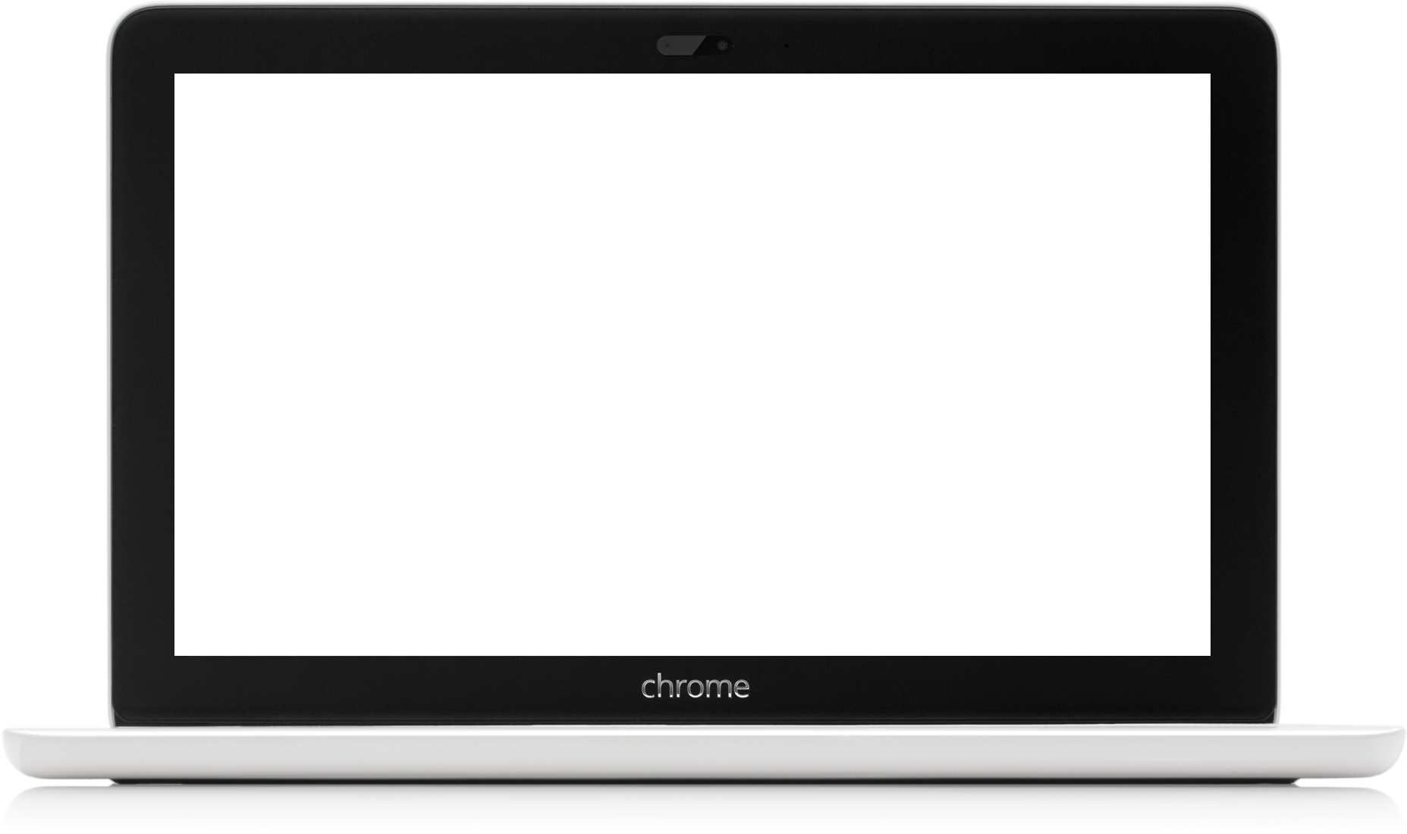
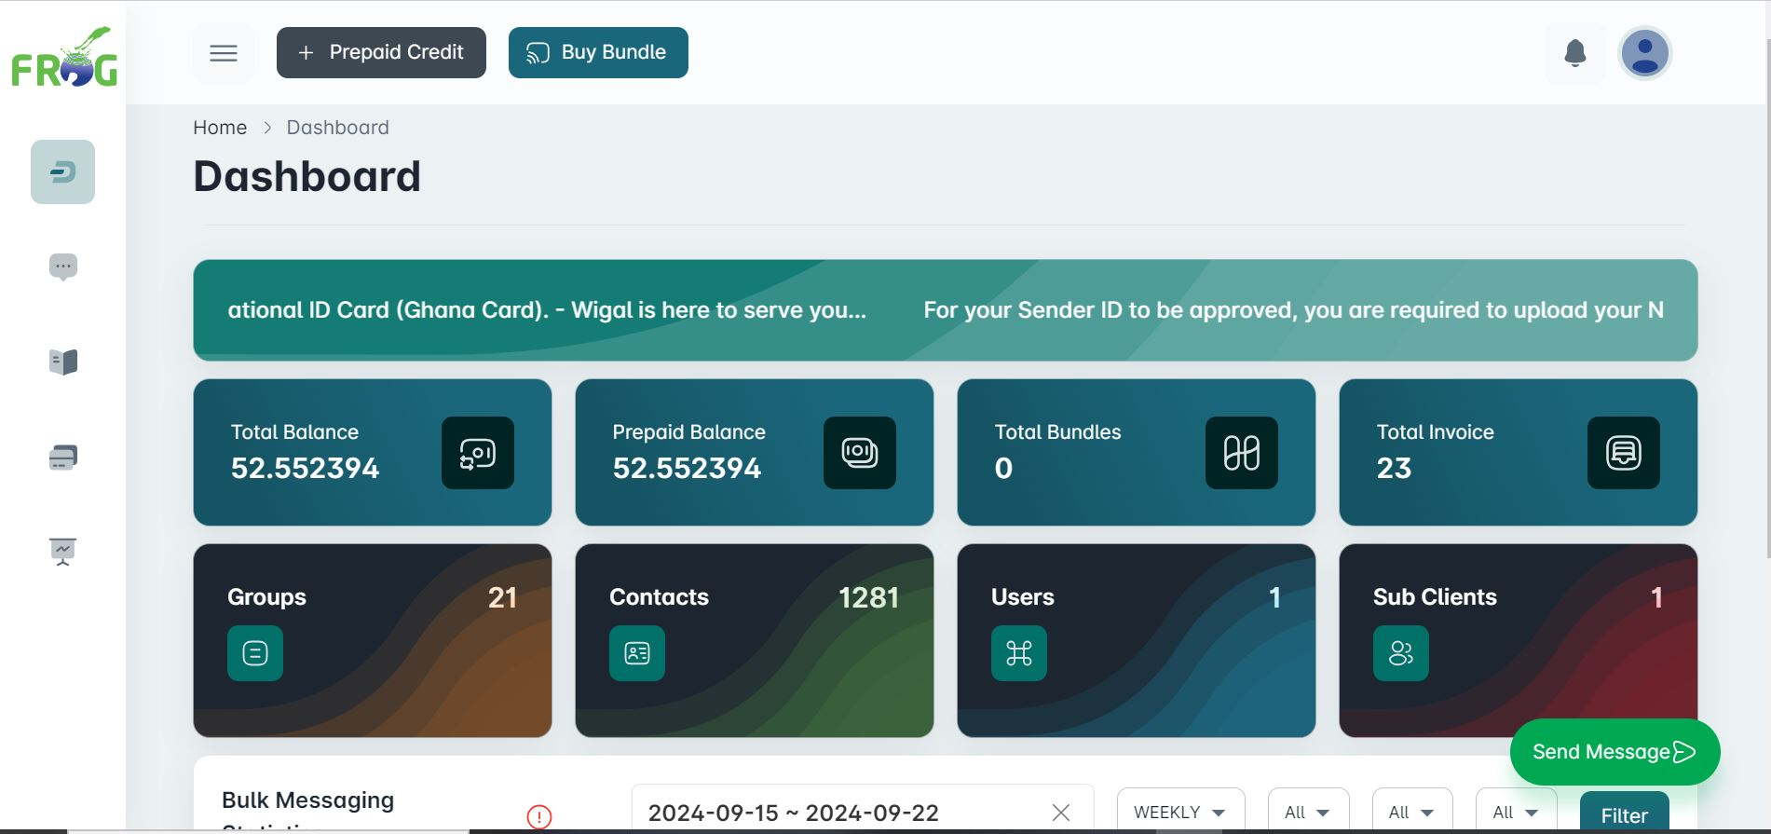
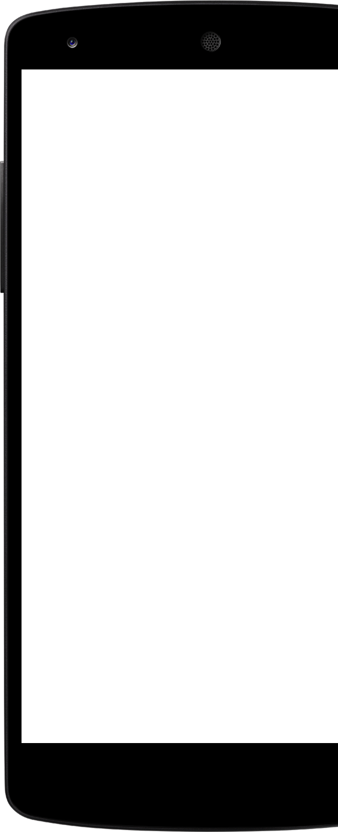
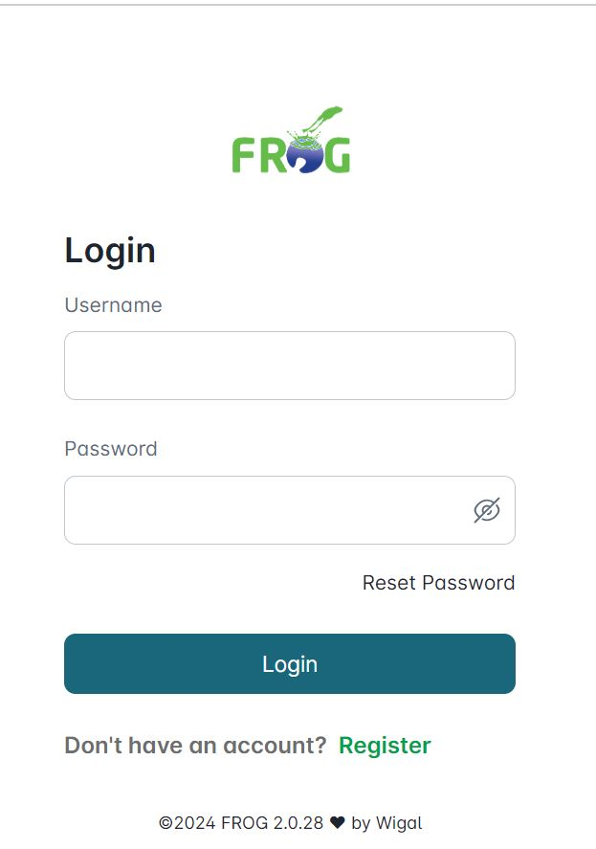
USING SMS FOR MINISTRY
Using the SMS Platform (FROG)
for church Management
A presentation by the Digital Ministry of the Great Commission Movement of Ghana (GCMG).

Slide 2
Outline
Introduction to FROG.
How do I access the FROG platform.
Create a FROG Account.
Activate your Email and Phone Number.
The FROG Dashboard.
Getting your Spreadsheet prepared
Send a Simple SMS Message.
Send a Bulk SMS Message.
Schedule Alerts ( Birthday/Anniversary)

Slide 3
Introduction to FROG
FROG is an acronym which stands for Fully Rely On GOD (FROG).
FROG is a web application platform designed to help it’s users send text messages (Bulk SMS), Voice SMS (Text-to-Speech, Call to Record, IVR Campaigns), and Bulk Emails to all contact across Ghana, and other parts of the world such as Nigeria, UK, USA, CANADA.

Slide 4
How do i access the FROG platform
Open google.com on any search browser
Search for the word “FROG WIGAL”
Click on the first option to access the FROG website (ie; https://sms.wigal.com.gh/)
On the website click on the sign in option, to directly access the FROG web application (ie: https://frog.wigal.com.gh/login)

Slide 5
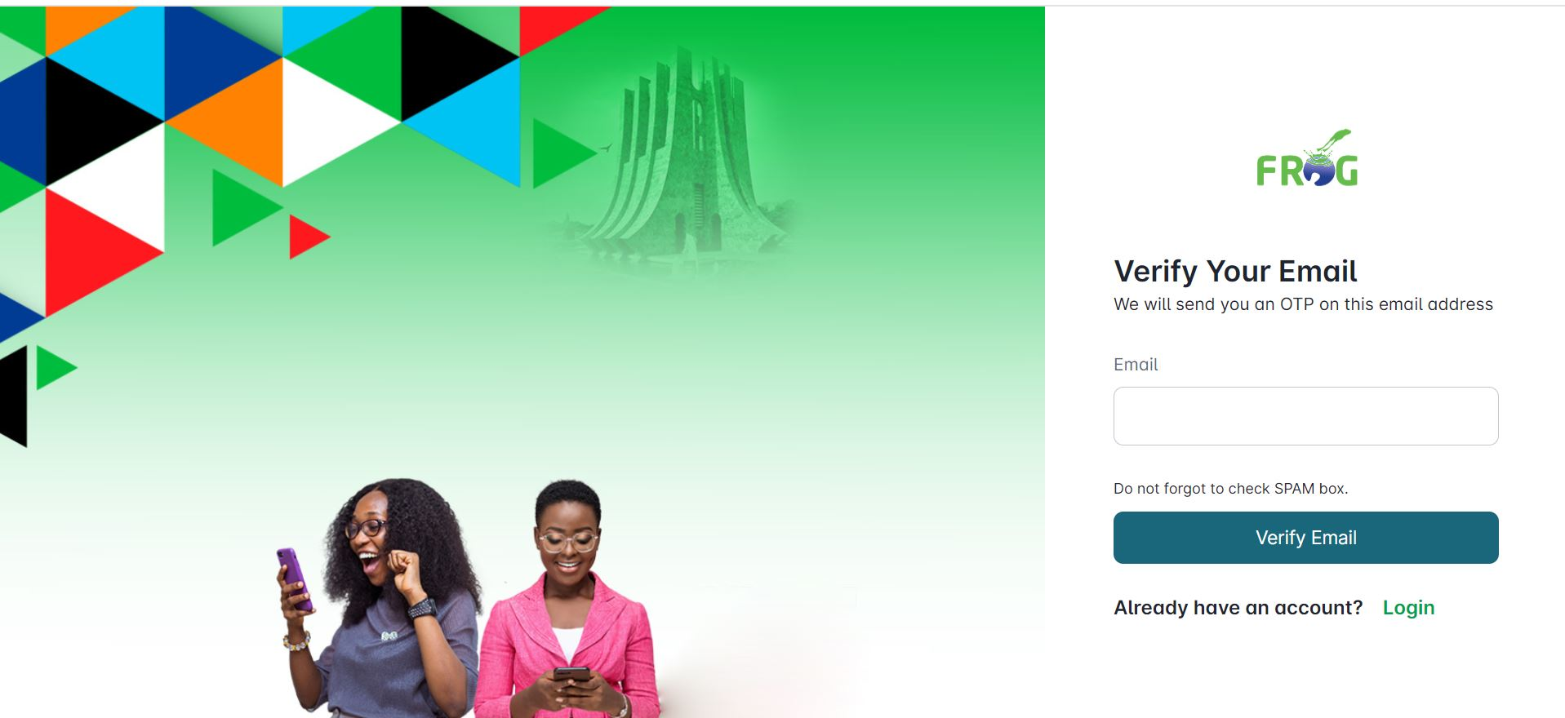
Create a FROG Account
Fill and complete the requested details below

Slide 6
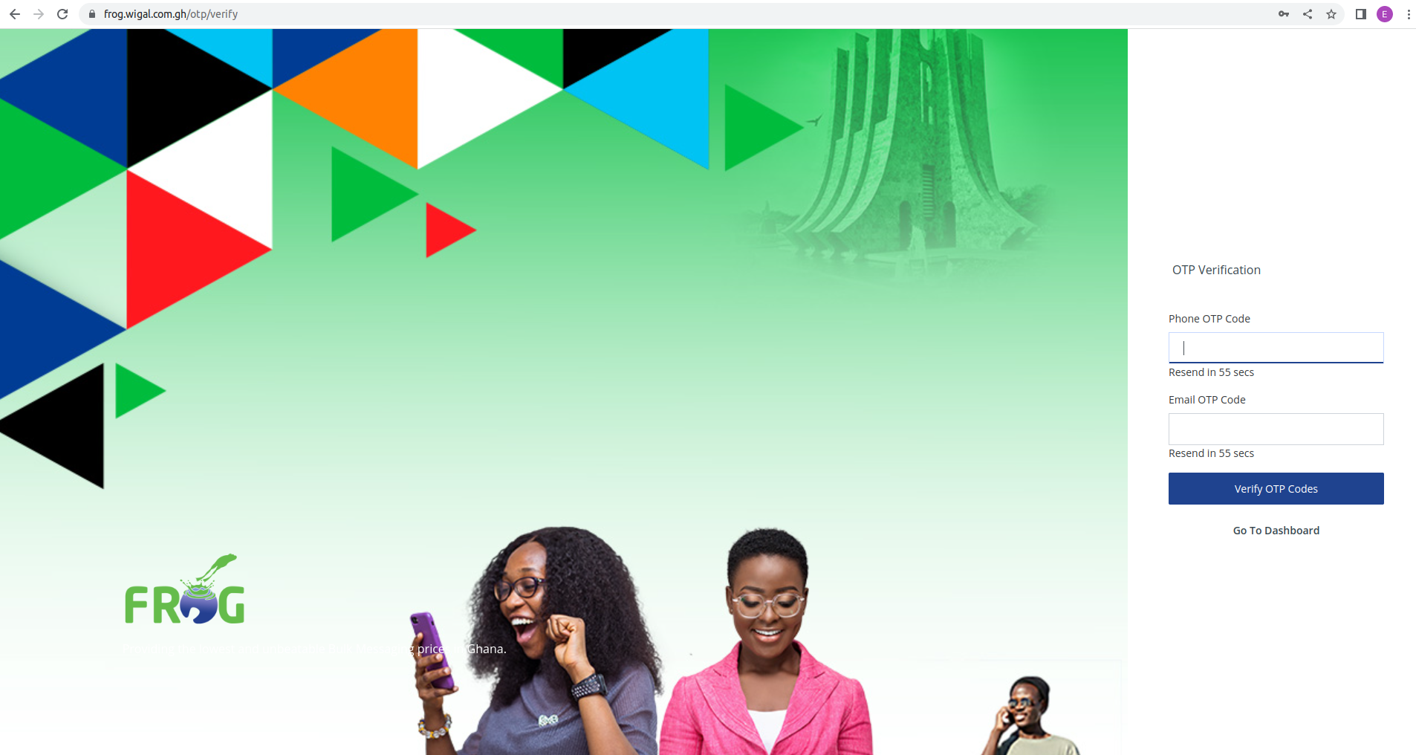
Activate your Email and Phone Number
Ensure that your Phone Number and Email are validated, in order to complete the signup process.

Slide 7
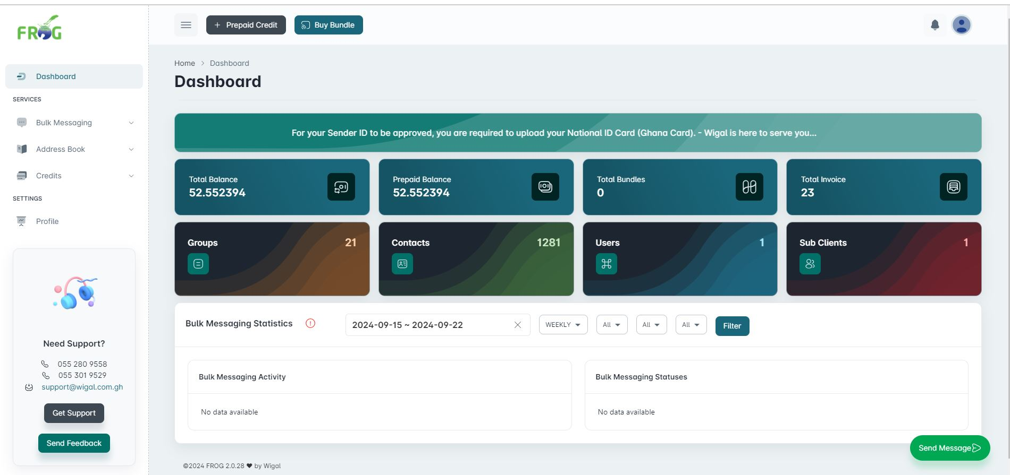
The FROG Dashboard
You now have access to your FROG dashboard

Slide 8
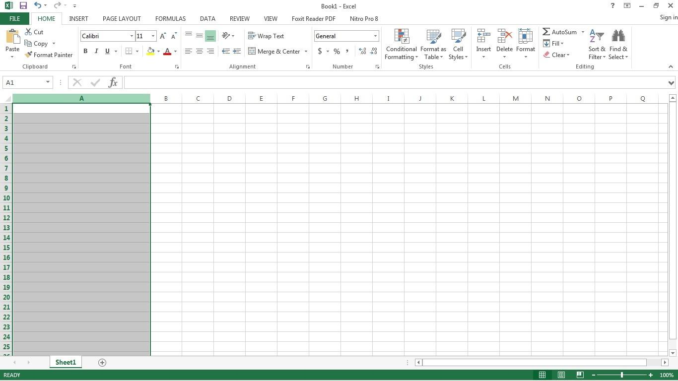
Getting your Spreadsheet prepared
Step 1
Click on the A (that is the column A) to select the entire column
Click on the Shaded ‘A‘ area to select the entire column to affect your formatting.
NB: All numbers should be entered in the first column which is column A.

Slide 9
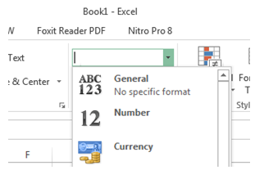
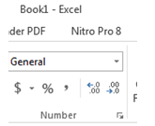
Getting your Spreadsheet prepared
Step 2
Change “General” is the text field to “Number” and click on the Decrease button twice to do away with the decimal places.
Decrease Decimal button

Slide 10
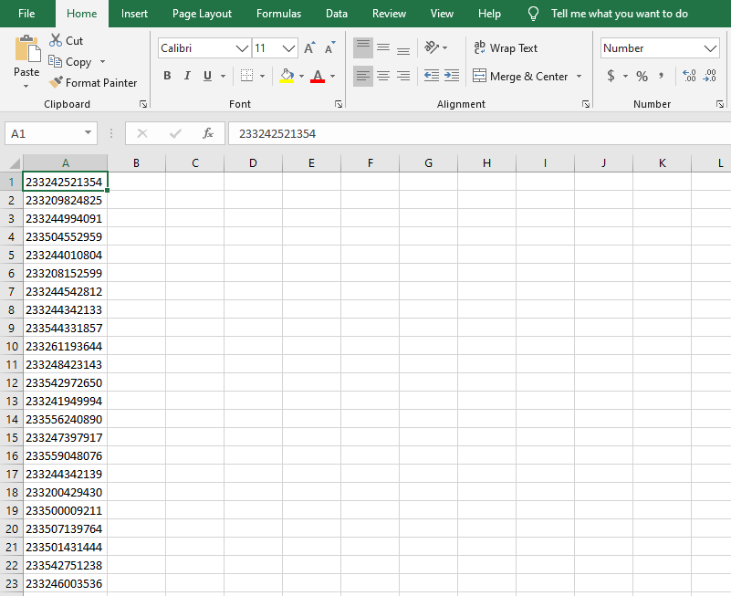
Getting your Spreadsheet prepared
Step 3
You can start entering your numbers preceding them with 233 e.g. 233242918679 or just use the normal format eg; 0242918679

Slide 11
Send a Simple SMS Message
To Send a Simple Message:
Navigate to Bulk Messaging and Select Send New Message.
Esure the Message type Option is selected to “Simple Message”
In the send message To: box, enter the recipient’s number. For multiple contacts, enter the numbers separated by a comma (,). (Eg: 0265188849,0547930735)
Select sender ID, Message type as Text and type the message to be sent. (Please Note: 160 characters = 1 credit)
Once done, Confirm to send messages.
You can also schedule a message by checking the “Schedule message for later” by providing the Date and Time.
Click on Cancel to cancel the simple message, if the need be.
Once you confirm the message, a summary page will be displayed, so you finally confirm on all the details provided.

Slide 12
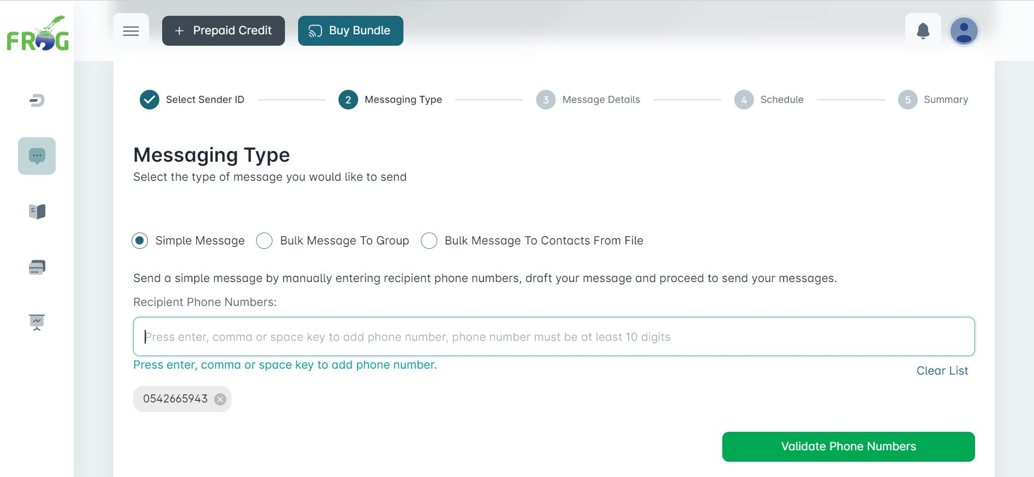
Send a Simple SMS Message
This is a screenshot of a simple message

Slide 13
Send a Bulk SMS Message
To Send a Simple Message:
Navigate to Bulk Messaging and Select Send New Message.
Esure the Message type Option is selected to “Bulk Message To Groups”
Select sender ID, Message type as Text and type the message to be sent. (Please Note: 160 characters = 1 credit)
Once done, Confirm to send messages.
You can also schedule a message by checking the “Schedule message for later” by providing the Date and Time.
Click on Cancel to cancel the simple message, if the need be.
Once you confirm the message, a summary page will be displayed, so you finally confirm on all the details provided.

Slide 14
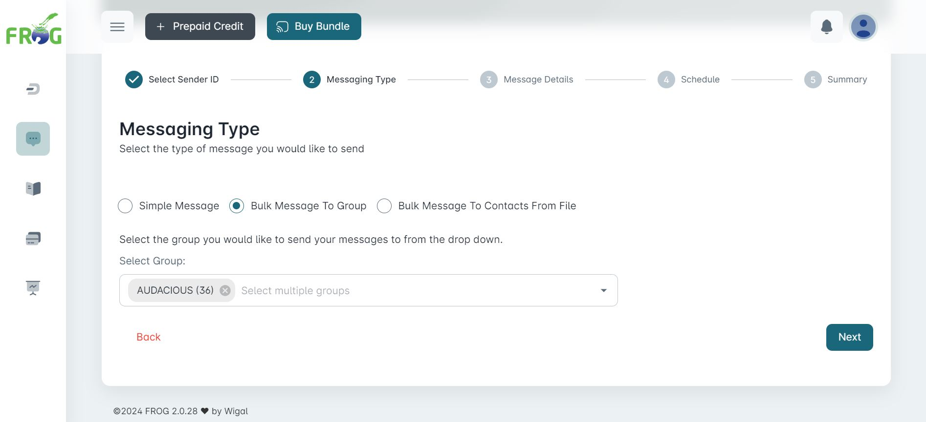
Send a Bulk SMS Message
This is a screenshot of a Bulk message

Slide 15
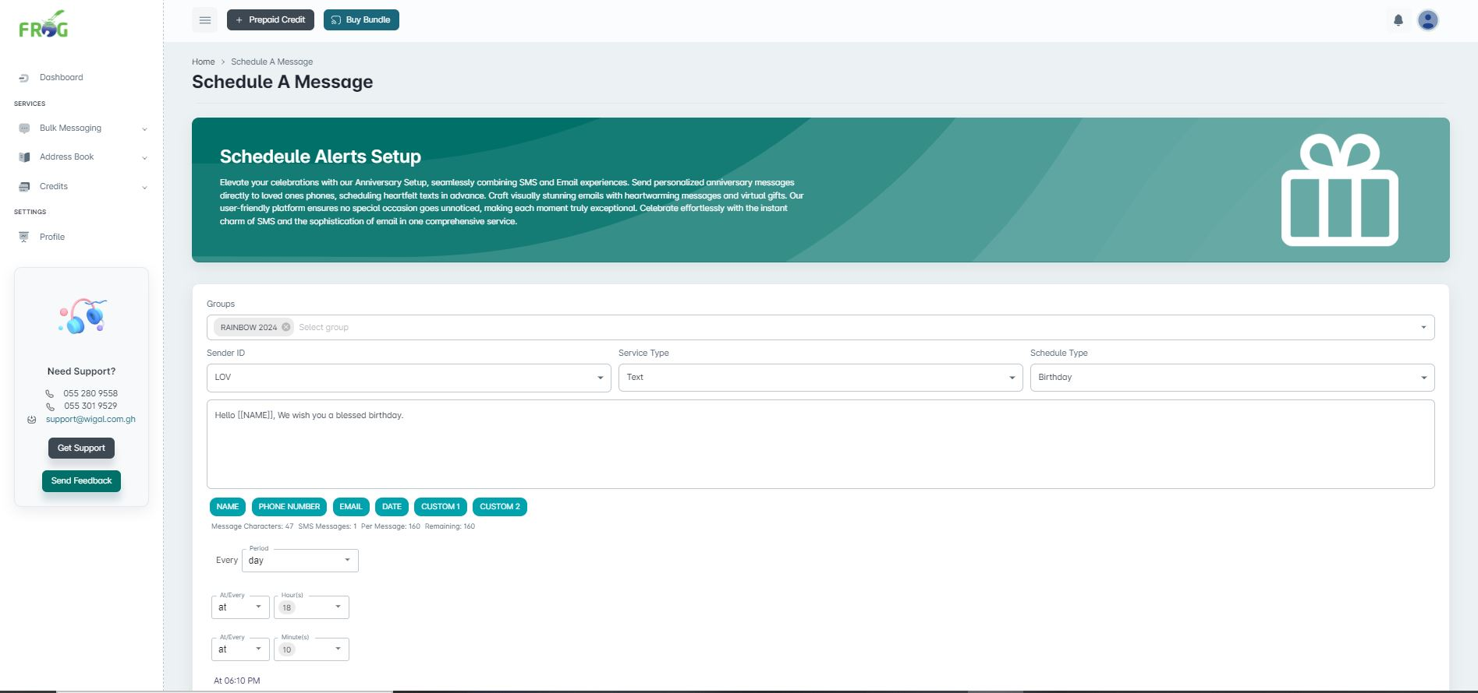
Schedule Alerts
This is a screenshot of a Bulk message

Slide 16
Questions & Answers

